Slide 1
Encapsulation

Slide 2

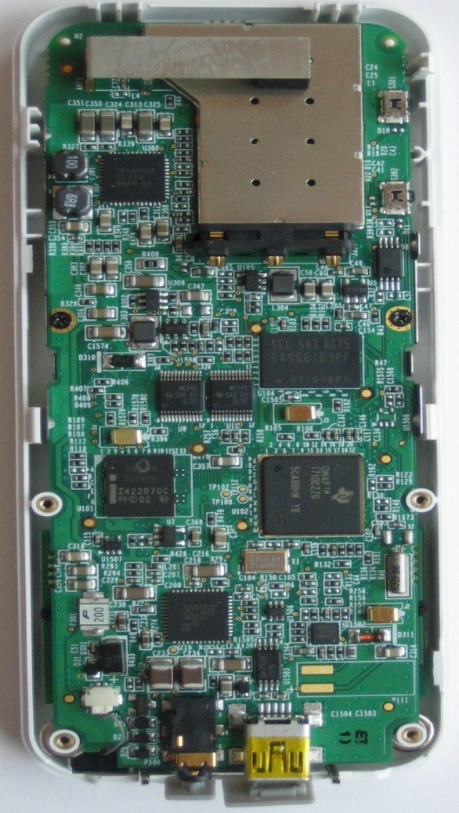
What problem would arise if internal details is accessible to the outside world?

Slide 3


What is inside?
A small container with medicines inside.
Capsule – encapsulate the medicines

Slide 4
Encapsulation
- to bind related functionality (Methods) & Data (Variables) in a protective wrapper (Class)
Encapsulation is used to hide its members from outside class or interface
so that the code can be saved from unauthorized access by outer world and can be made easy to maintain.

Slide 5
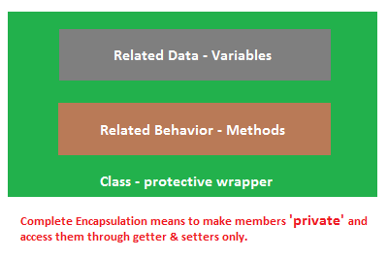
Encapsulation

Slide 6
Encapsulation
In encapsulation the variables of a class will be hidden from other classes, and can be accessed only through the methods of their current class, therefore it is also known as data hiding.

Slide 7
Encapsulation
Encapsulation is a process of wrapping code and data together into a single unit,
For example capsule which is mixed of several medicines.
We can create a fully encapsulated class in java by making all the data members of the class private. Now we can use set and get methods to set and get the data in it.

Slide 8
Encapsulation
Objects encapsulate data and implementation details. To the outside world, an object is a black box that exhibits a certain behavior.
The behavior of this object is what which is useful for the external world or other objects.
An object exposes its behavior by means of public methods or functions.
The set of functions an object exposes to other objects or external world acts as the interface of the object.

Slide 9
What is Access Specifiers in C#?
Access Specifiers defines the scope of a class member. A class member can be variable or function. In C# there are five types of access specifiers are available.
Public Access Specifiers
Private Access Specifiers
Protected Access Specifiers
Internal Access Specifiers
Protected Internal Access Specifiers.

Slide 10
Public Access Specifiers (C#)
The class member, that is defined as public can be accessed by other class member that is initialized outside the class. A public member can be accessed from anywhere even outside the namespace.

Slide 11
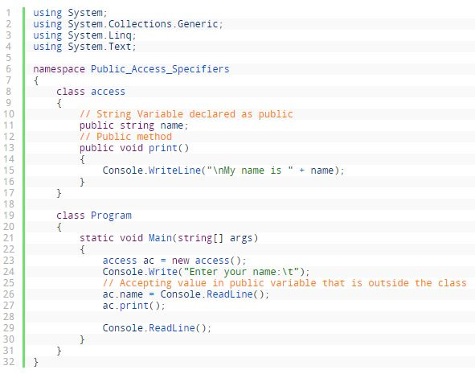

Slide 12
Private Access Specifiers (C#)
The private access specifiers restrict the member variable or function to be called outside from the parent class. A private function or variable cannot be called outside from the same class. It hides its member variable and method from other class and methods. However, you can store or retrieve value from private access modifiers using get set property.

Slide 13
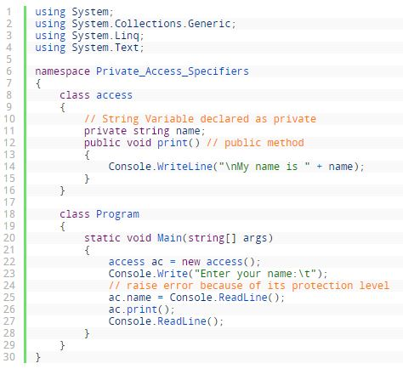
Error 1: Private_Access_Specifiers.access.name’ is inaccessible due to its protection level _

Slide 14
Protected Access Specifiers C#
The protected access specifier hides its member variables and functions from other classes and objects. This type of variable or function can only be accessed in child class. It becomes very important while implementing inheritance.

Slide 15
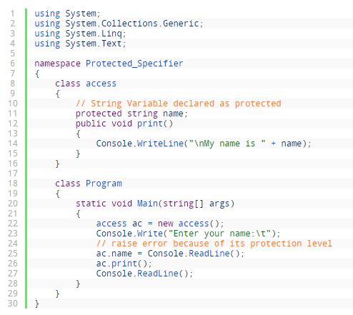
‘Protected_Specifier.access.name’ is inaccessible due to its protection level.

Slide 16
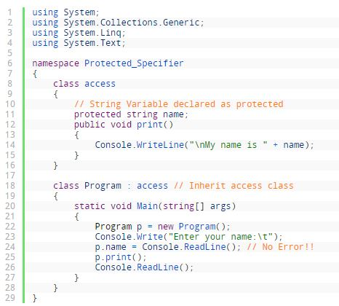

Slide 17
C# Internal Access Specifiers
The internal access specifier hides its member variables and methods from other classes and objects, that is resides in other namespace. The variable or classes that are declared with internal can be access by any member within application. It is the default access specifiers for a class in C# programming.

Slide 18
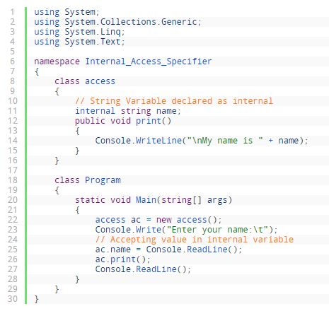

Slide 19
C# Protected Internal Access Specifiers
The protected internal access specifier allows its members to be accessed in derived class, containing class or classes within same application. However, this access specifier rarely used in C# programming but it becomes important while implementing inheritance.

Slide 20
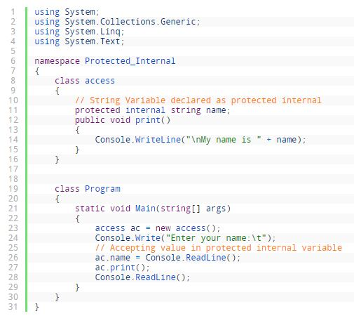

Slide 21
C# Get Set Modifier
The get set accessor or modifier mostly used for storing and retrieving value from the private field. The get accessor must return a value of property type where set accessor returns void. The set accessor uses an implicit parameter called value. In simple word, the get method used for retrieving value from private field whereas set method used for storing value in private variables.

Slide 22
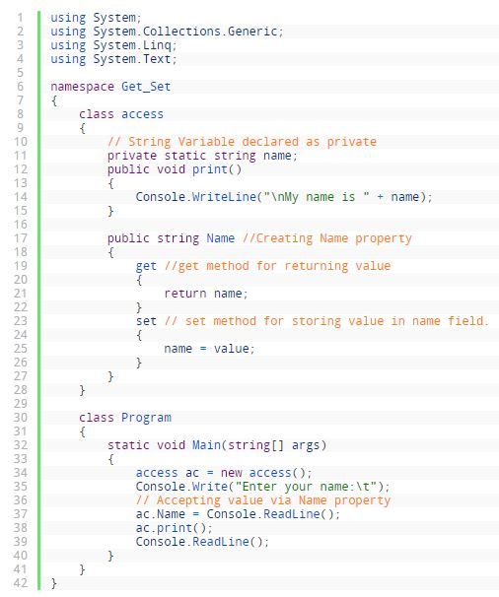

Slide 23
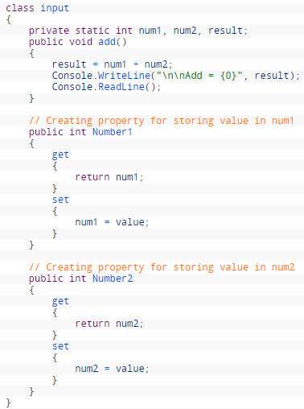
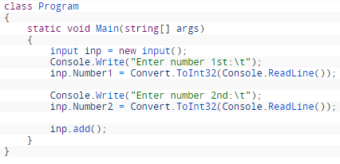

Slide 24
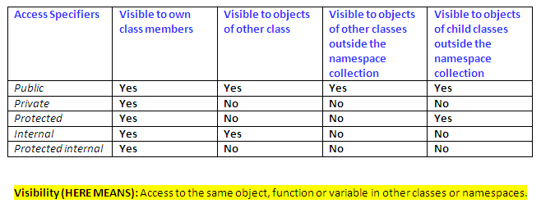
Access Modifier
yes
yes
Notes:
yes

Slide 25
Advantage of Encapsulation
Encapsulation plays an important role in object oriented programming. It can be defined as concealing decisions which are related to the design of a computer program.
The purpose of encapsulation is to protect the other parts of the application from changing when one piece of information is changed. To conceal a design decision, a programmer will need to build a strong interface. This interface will cover the rest of the application from any changes that are made.
In contemporary programming languages, the concept of encapsulation has been used in a number of different ways. While some people choose to use encapsulation as a general term for hiding information, others use it in a manner which is much more specific.

Slide 26
Advantage of Encapsulation
object oriented programming, the software module may hide the data by encapsulating it within a module which showcases an interface. It will reduce the chances of a software being damaged during its development by transferring the dependency of the code into an interface which is secure.
The elements will carry out operations on the interface so that if a change occurs, it is not necessary for the clients to change as well. In most cases, the information will be hidden by concealing the layout of the data. If the layout is altered, the change will be reduced to a small portion of the program.

Slide 27
Advantage of Encapsulation
By providing only setter or getter method, you can make the class read-only or write-only.
It provides you the control over the data. Suppose you want to set the value of cgpa is greater than 3.8, then the grade is A+.

Slide 28
Qu 1: Write a program to demonstrate private access specifier.
Qu2: Write a program to explain protected access specifier.
Qu3: Write a program to store and retrieve value from private variable using get set property.

